Slide 1
IBM CAPSTONE PROJECT – The Battle of Neighborhoods: Analysis of London Real Estate Market

Slide 2
Business Problem section
Real Estate in London is suffering from compounding problems. Some reasons for this crisi are listed below-London Housing Market is in a rut:
Brexit
Unoccupied proprties
Record-low sales
Homebuilder exodus
New Projects restricted by green belts with restriciton on cosntruction.

Slide 3
Business Problem
300K thousand move to London every year with an intention to stay short term or long term. How can we provide support to homebuyers customers with information on property and prices to help them purchase suitbale real estate in these unstable and rapidly changing London Real Estate Market.

Slide 4
Solution
Collecting infroation in various London Housing areas and then Clustering neighborhoods in order to recommend venues and the current average price of real estate where homebuyers can make a real estate investment.

Slide 5
Data and Methodology
Data: merging data on London properties and the relative price paid data from the HM Land Registry and data on amenities and essential facilities surrounding such properties from FourSquare API interface.
Mehodology:
Collect Inspection Data;
Explore and Understand Data;
Data preparation and preprocessing;
Modeling

Slide 6
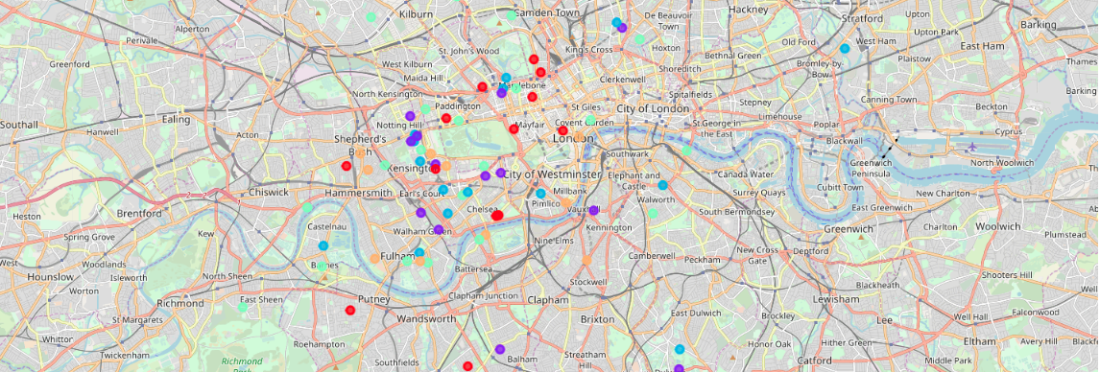
K-Means clustering

Slide 7
Outcome:
Examination of real estates according to neighborhoods/London areas
West London (Notting Hill, Kensington, Chelsea, Marylebone) and North-West London (Hampsted) might be considered highly profitable venues to purchase a real estate;
South-West London (Wandsworth, Balham) and North-West London (Isliington) are arising as next future elite venues with a wide range of amenities and facilities.
Examination of real estates by clusters
Clusters 0, 2 and 4 may target home buyers prone to live in 'green' areas with parks, waterfronts;
Clusters 1 and 3 may target individuals who love pubs, theatres and soccer.

